Slide 1

Battle of the Neighborhoods: Where to open Italian Restaurant in New York City
Gergana Topalova

Slide 2
Introduction:
This final project explores the best locations for opening an Italian Restaurant in New York City and its five major Boroughs. New York City has long been considered as one of the Food Capitals of the World and it is also the place, I call home for the last 11 years. NYC is a major metropolitan area with more than 8 million people living within city limits. It is one of the most diverse cities worldwide and considered a safe haven for immigrants.
This report explores which neighborhoods and boroughs in New York City have the most and the best Italian restaurants.
We will try to answer the questions:
Where are the best places to open an Italian Restaurant? And
Where should one go for a taste of the best Italian food in the city?”

Slide 3
Data:
To answer those questions, we will use different datasets related to New York City neighborhoods as well FourSquare API data to obtain the required restaurant likes, ratings and tips.
The main data sources will be some URL open source dare available to us like:
https://cocl.us/new_york_dataset , which will give us data about New York City neighborhoods and boroughs and their latitudes, and longitudes.
https://data.cityofnewyork.us/City-Government/Borough-Boundaries/tqmj-j8zm - This dataset contains neighborhood boundaries and other addition information related to the issues at hand.
as well as:
FourSquare API requests that will be used to obtain categories, restaurant ratings, tips, likes etc.

Slide 4
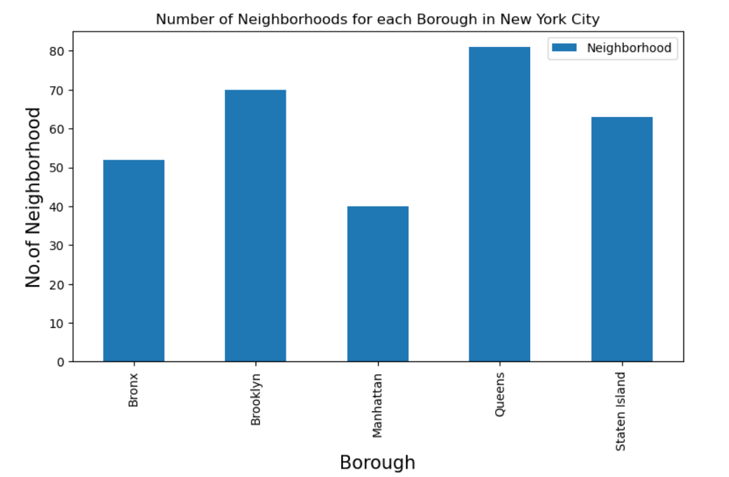
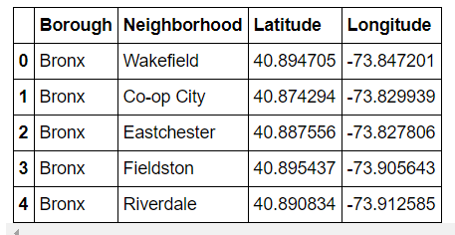
Data Analysis Neighborhood Data:
Panda Dataframe of Neighborhood data – Latitude and Longitude:
Number of Neighborhoods in each Borough:

Slide 5
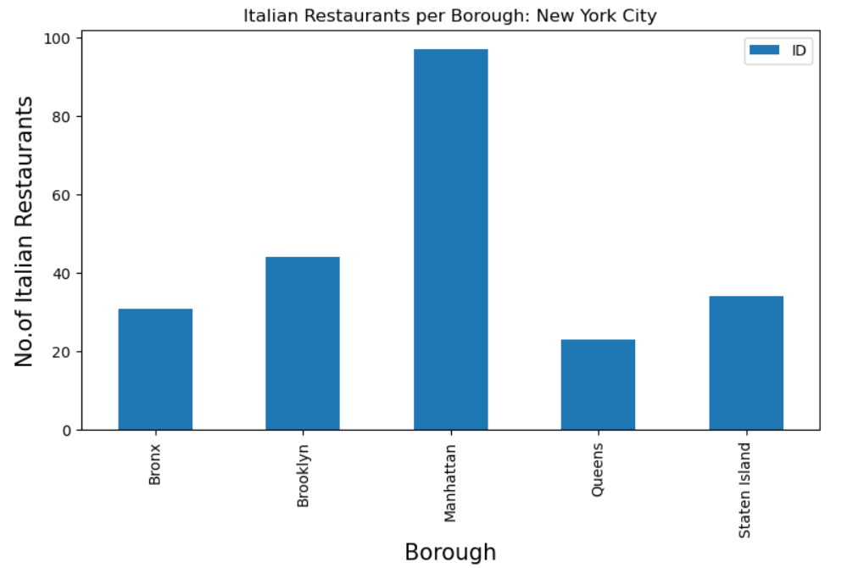
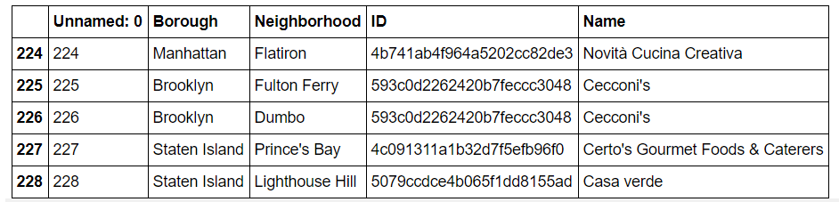
utilizing the Foursquare API to explore the neighborhoods and segment them. this report will show how many Italian Restaurants there are and where are they located in the city(which Neighborhood).
Using matplotlib to visualize where exactly are they situated by Borough and Neighborhood:
Manhattan has the most Italian Restaurants even though it the Borough with the least number of Neighborhoods. That means that the concentration of Italian Restaurants in Manhattan is much higher that any other Neighborhood.
From the table we can see that there are 229 Italian Restaurants in New York City

Slide 6
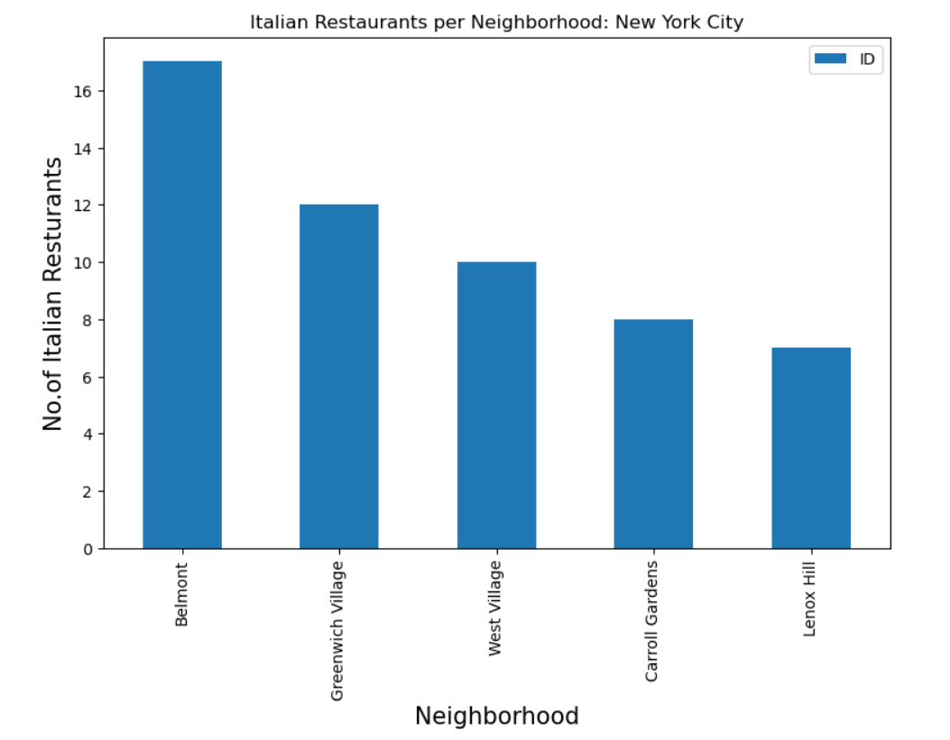
The top 3 Neighborhoods with the biggest concentration of Italian Restaurants are Belmont, Greenwich Village and West Village which are in the Boroughs of The Bronx and Manhattan. From them Greenwich Village and West Village are located in an area of the city that is popular with both tourists and locals alike withe Greenwich Village having the most restaurants.

Slide 7
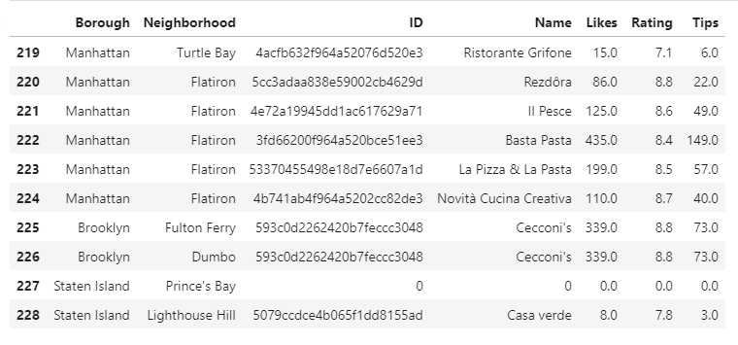
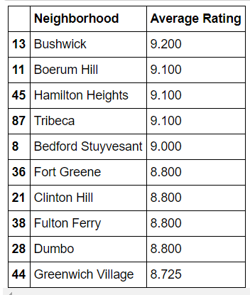
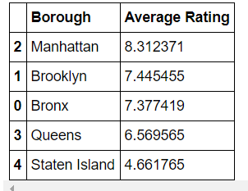
The table above shows the ranking of each restaurant. I set the FourSquare API category to Italian Restaurants and extracted the venue_details(ID) of Likes, Rating and Tips for each ID. we can see that there is a correlation between the number of Likes and the Rating – the Restaurants with more Likes also have higher Rating. In regards of that information I decided continuing ahead to concentrate solely on the Ratings.
Now that we have that information let's see which are the Boroughs and Neighborhoods with the highest Average Rating using the .groupby function:

Slide 8
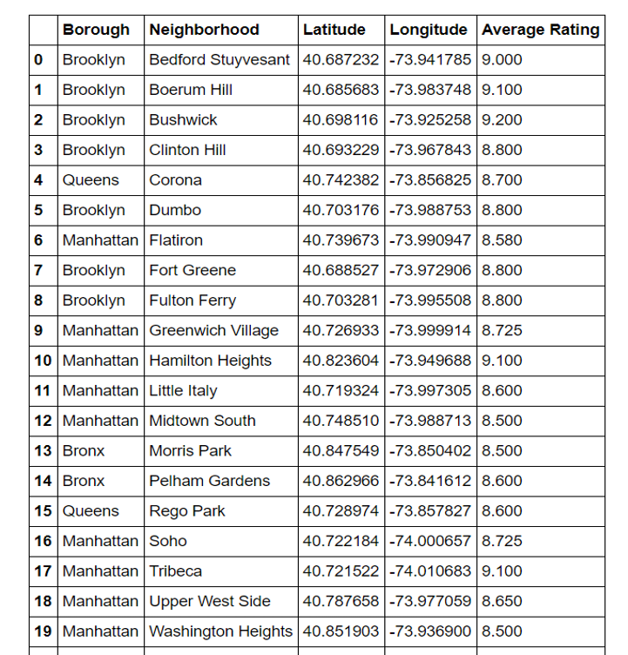
Restaurants with Average Rating >=8.5: The Borough with the highest Average of 9.1Rating is Manhattan. The Neighborhoods of Tribeca (Manhattan), Hamilton Heights (Manhattan)and Bushwick (Brooklyn) are some of the best neighborhoods for Italian cuisine with Average Rating and 9.2.

Slide 9
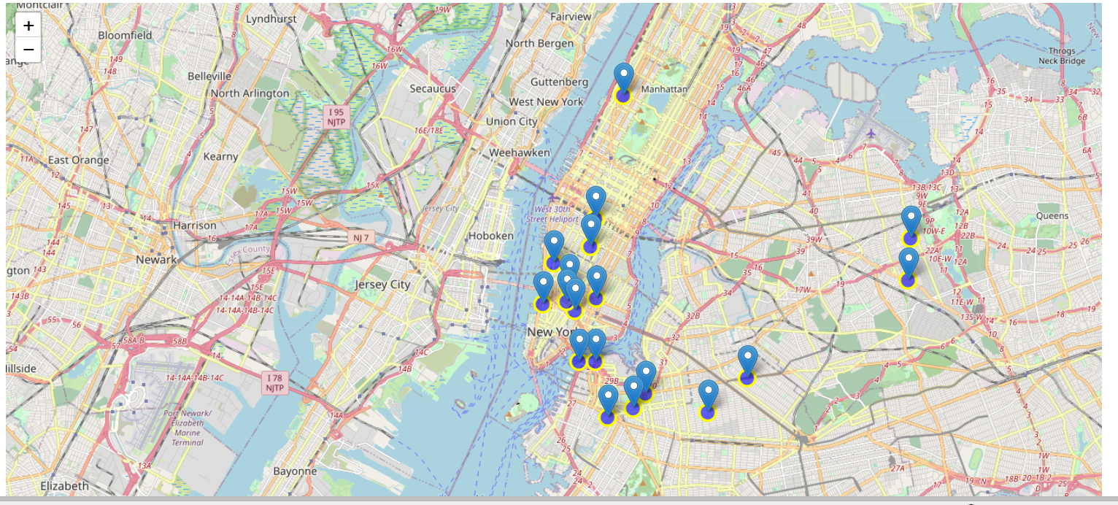
Italian Restaurants with Average Rating higher than 8.5
Folium Map:

Slide 10
Results / Conclusion:
Here are the conclusions that I manage to extrapolate after reviewing the problem and analyzing the data:
Manhattan and Brooklyn have the best rated Italian restaurants on average.
Tribeca (Manhattan), Hamilton Heights (Manhattan)and Bushwick (Brooklyn) are some of the best neighborhoods for Italian cuisine with Average Rating of 9.1 and 9.2. However, from those 3 only Tribeca is located in an area of the city that is popular with both tourists and locals alike the other two Neighborhoods are mostly residential.
Manhattan is also the Neighborhood with the biggest concentration of Italian restaurants and have booming Italian Cuisine Market
In conclusion Tribeca (Manhattan) is the best place to open Italian Restaurant.
If we are just looking for a spot to enjoy good Italian food, we should definitely check out and the Neighborhoods of Hamilton Heights, Bushwick and if my personal favorite Greenwich Village all with Average Rating over 8.5

